Slide 1
Feature & Benefits
Application
Testing
Maintenance

Slide 2
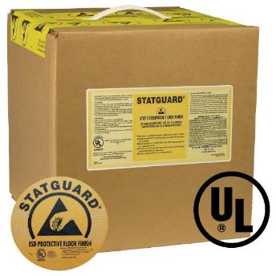
Statguard® Products
STATGUARD® FLOOR FINISH
Part No. | Gallons
46000 | 2.5 Gal Box
46001 | 5 Gal Box
Low humidity formulation provides greater durability and performance in all humidity environments
Cross-linked polymer produces a glossy, long lasting, durable finish for a beautiful ESD floor finish that stands up to heavy traffic but is easier to strip
UL classified for slip resistance
18% solids for easy application; improves productivity
Low Tribocharging, static dissipative
Lead-free RoHS 2, REACH, and Conflict Minerals compliant
Responds well to spray buffing and dry burnishing to restore electrical properties and luster with minimal labor
Made in the United States of America
Click Here for Cleanroom and Raised Floor application instructions TB-7042 - Statguard® Dissipative Floor Finish Installation and SDS

Slide 3
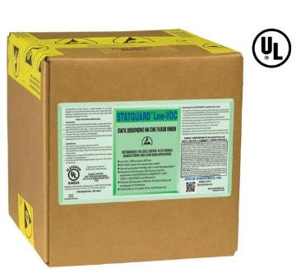
Statguard® Products
STATGUARD® LOW-VOC FLOOR FINISH
Better Hardness vs. Leading Competition – ASTM Standard D2134.93 Resists wear in order to maintain ESD performance longer
Part No. | Gallons
46024 | 2.5 Gal Box
46025 | 5 Gal Box
Static Dissipative Zinc Free Floor Finish
Convert hard non-ESD floors to ESD protective flooring
Protect and enhance ESD permanent flooring (Vinyl, VCT, Rubber)
Low-VOC - Meets CARB and other regional VOC requirements
Dissipative Coating - (1 x 10⁷ to < 1 x 10⁹ ohms) - ANSI/ESD STM7.1 and ESD TR53
Low Tribocharging Coating - (<100 volts) ANSI/ESD STM 97.2 -
23% Solids - 2 Coat System - Reduces labor needed for initial install and on-going maintenance of the floor
Lead-free RoHS 2, REACH, and Conflict Minerals compliant
UL classified for slip resistance
Made in the United States of America
Click Here for Cleanroom and Raised Floor application instructions TB-7055 - Statguard® Dissipative Floor Finish Installation and SDS

Slide 4
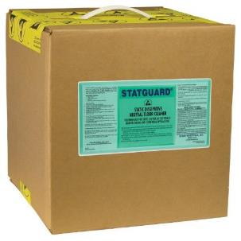
Statguard® Products
STATGUARD® NEUTRAL FLOOR CLEANER
Labor saving dissipative cleaner leaves floor clean and free of insulative film with no rinsing
Does not leave insulative residues behind
Cleans dissipative and conductive floors and tiles
Formulated with dissipative agents that rejuvenate the properties of Statguard® Floor Finish
Lead-free RoHS 2, REACH, and Conflict Minerals compliant
Made in the United States of America
Part No. | Gallons
46030 | 2.5 Gal Box
46031 | 5 Gal Box
TB-7041 - Statguard® Neutral Floor Cleaner Installation MSDS

Slide 5
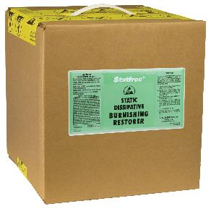
Statguard® Products
STATFREE ® BURNISHING RESTORER
Ready-to-use formulation that enhances gloss well beyond burnishing alone
Uses standard burnishing machine - Clean and prepare the ESD flooring for burnishing in one simple step
Keeps the wet look on floors without the need for refinishing
Unique formula extends re-coat cycle
Extends ESD floor electrical properties and restores gloss; reduces cost
The surface resistance (1 x 10⁷ to < 1 x 10¹⁰ ohms) meets the ANSI/ESD S20.20
Lead-free RoHS 2, REACH, and Conflict Minerals compliant
Made in the United States of America
Part No. | Gallons
46011 | 2.5 Gal Box
TB-7044 - Statfree® Dissipative Burnishing Restorer: Application Instructions & MSDS

Slide 6
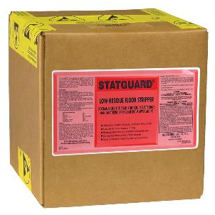
Statguard® Products
STATGUARD® LOW RESIDUE FLOOR STRIPPER
Strips resilient floors with low pH formula
Reduce rinse time and cutting labor costs by 20% over conventional strippers
Low pH formulation is designed to break up and lift multiple layers of Statguard® Floor Finish
High grade, non-ammoniated, biodegradable and phosphate free
Lifts ESD floor finish from vinyl, concrete, rubber, terrazzo, quarry tile, brick, slate, and unglazed ceramic
Lead-free RoHS 2, REACH, and Conflict Minerals compliant
Made in the United States of America
Part No. | Gallons
46020 | 2.5 Gal Box
46021 | 5 Gal Box
TB-7026 - Statguard® Floor Stripper: Application Instructions & MSDS

Slide 7
Statguard® Features
WHY USE STATGUARD® FLOOR FINISH?
Static dissipative. Rtt = 10⁷ – 10⁹ Ohms through 10% - 65% RH
Charge decay to zero volts from 5000 volts in .01 seconds
Low Tribocharging, will not generate greater than 100 volts even under 10% RH
High performance proprietary X-linked polymers for hardness and durability
UL listed for slip resistance, high coefficient of friction
Non-water whitening
Used in clean rooms down to class 1000
30 years performance history with Statguard®
18% Solids (standard Statguard® Floor Finish)
23% Solids (Low VOC Statguard® Floor Finish)

Slide 8
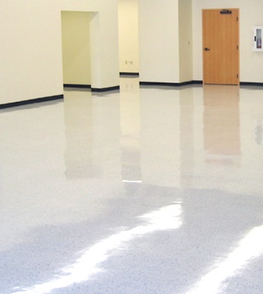
Statguard® Features
STATGUARD® BENEFITS
Easy to apply
Turns standard flooring into an ESD protected floor
Provides superior gloss with easy maintenance
Provides a clear durable coating to allow grounding of mobile personnel and equipment
Eliminates Tribocharging on mobile personnel and equipment
Electrical properties verified using standard test methods

Slide 9
Statguard® 1-2-3 Application
The Tools
The Application
Testing

Slide 10
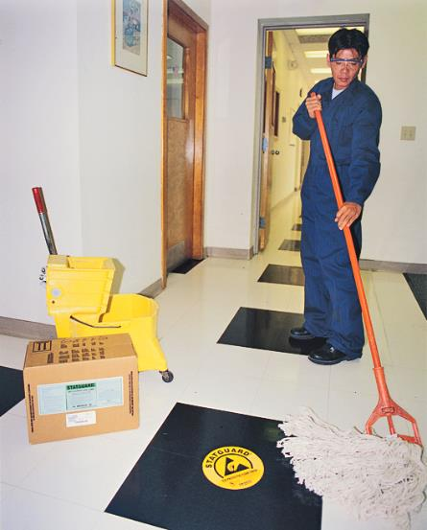
Statguard® 1-2-3 Application
THE TOOLS
Rayon Mop
Dedicated mop*
Bucket
Dedicated bucket*
Statguard® Finish
Quality ESD finish
*Dedicated Tools Eliminate Contamination

Slide 11
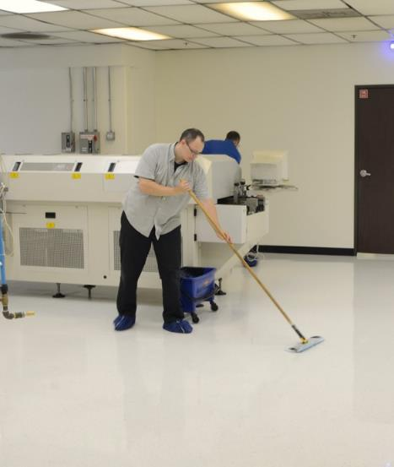
Statguard® 1-2-3 Application
THE APPLICATION
Floor Prep
Strip away old finish
Rinse 2 times or until pH is between 7 and 8
Let floor dry
Application
Standard - 3 coats / Low VOC - 2 coats
Dry time
45 minutes minimum each coat
Light traffic overnight
Last coat completely hardens in 72 hours

Slide 12
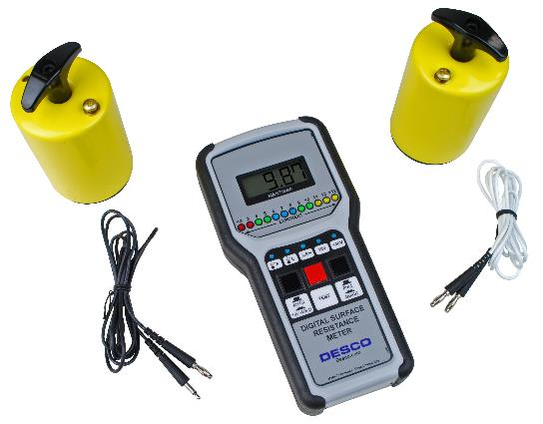
Statguard® 1-2-3 Application
THE TESTING
Resistance to Ground (Rtg)
1x10⁷ to 1x 10⁹ Ohms
Surface Resistance (Rtt)
1x10⁷ to 1x 10⁹ Ohms
Charge Decay
5,000 volts to 0 < 0.01 sec
Low Tribocharging Surface
Less than 100 volts (Meets ANSI/ESD S20.20)
19787 - Desco Digital Surface Resistance Meter Kit TB-3062 - 19787: Installation, Operation and Maintenance

Slide 13
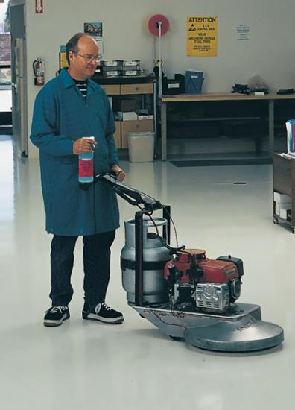
Statguard® Maintenance
MAINTENANCE TECHNIQUES
Dry mop
Gloss Damp Mop
Clean Damp Mop
Spray Buff
Burnish

Slide 14
Statguard® Maintenance
DRY MOP PROGRAM
Equipment
Process
Untreated push broom or dry mop
Push broom
Benefit
Removes dirt, grit and dust from wearing & scratching floor
Frequency
Once a night or as required.

Slide 15
Statguard® Maintenance
GLOSS DAMP MOP PROGRAM
Equipment
Untreated push broom
3:1 water & Statguard® Floor Finish mix
Process
Push broom area
Damp mop area
Benefit
Increases Gloss
Removes dirt, grit and dust from wearing & scratching floor
Frequency
Once a week or as required

Slide 16
Statguard® Maintenance
CLEAN DAMP MOP PROGRAM
Equipment
Untreated push broom
Statguard® Cleaner
Process
Push broom area
Damp mop area
Benefit
Cleans heel marks and stains
Removes dirt, grit and dust from wearing & scratching floor
Frequency
Once a night or as required
Note: The clean damp mop process may reduce the tile gloss

Slide 17
Statguard® Maintenance
SPRAY BUFF PROGRAM
Equipment
Untreated dust mop
Spray bottle (3 parts water to 1 part Statguard® finish)
175-1500 RPM buffer / white or beige pad
Process
Push broom area
Spray and buff
Benefit
Repairs scratches, removes marks and stains
Increases Gloss
Frequency
Once a week or as required

Slide 18
Statguard® Maintenance
BURNISH PROGRAM
Equipment
Untreated dust mop
1-2000 RPM Burnisher
White pad
Process
Push broom area
Dry Burnish 1-2000 RPM
Dust mop
Benefit
Cleans heel marks
Increases Gloss
Frequency
Once a week or as required

Slide 19
CONTACT US
Phone: (781) 821-8370
Service@StatguardFlooring.com

